Slide 1

My Algebra Interactive Notebook
Name
Class
Teacher
Semester 2
Term 3
1

Slide 2

Interactive Notebooks!
Cover Page
Contents Page
Glossary
24/7/30
EQ
Questions
Notes
Summaries
Work page
Presentation!!!
Your book, your responsibility!

Slide 3
Daily Homework Quiz
From last class. Solve the following…
1. 8g – 2 + g = 16
4. 2m – 6 + 4m = 12
ANSWER
2
ANSWER
3
2. 3b + 2(b – 4) = 47
ANSWER
11
5. 6a – 5(a – 1) = 11
3. –6 + 4(2c + 1) = –34
ANSWER
6
ANSWER
–4

Slide 4
For this next activity you’ll need:
A mini whiteboard
A whiteboard marker
Something to erase with

Slide 5
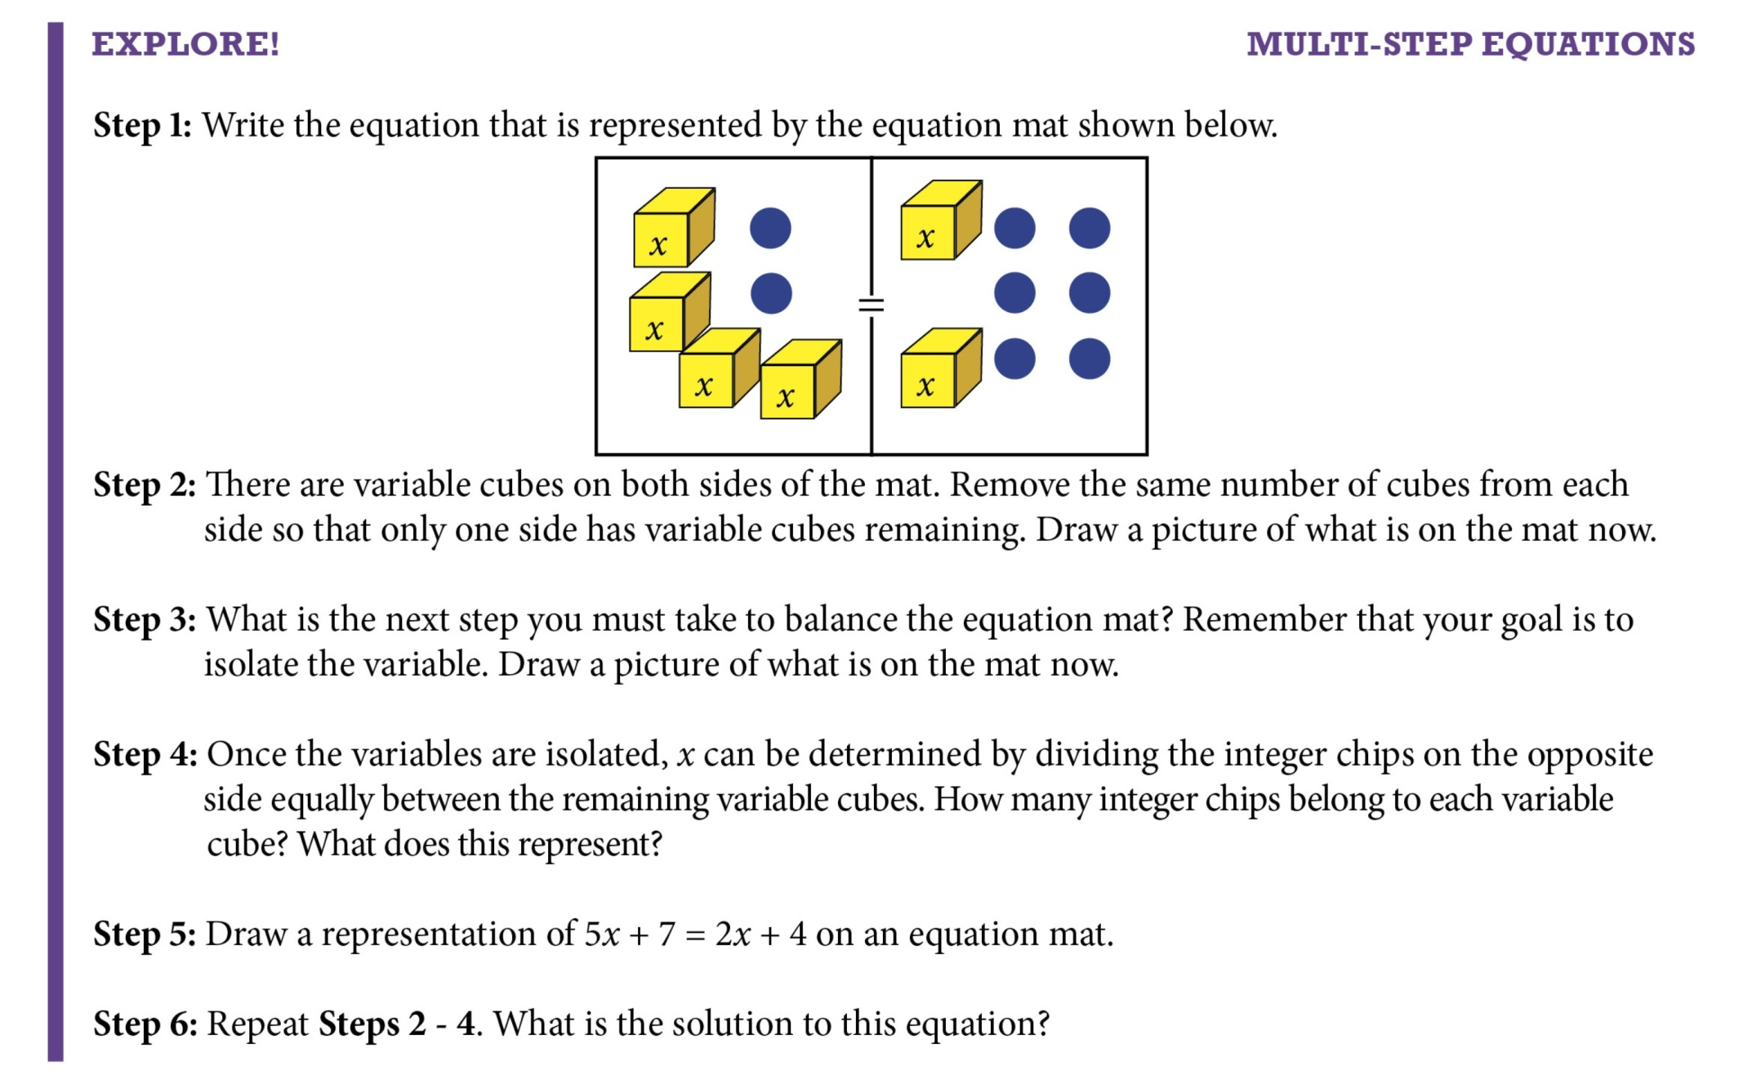

Slide 6
24
7
30
Solving Multi-Step Algebraic Equations
Date
EQ – How do we solve more advanced multi-step equations cont…?
Solving Multi-Step Equations
Simplify each side of the equation by distributing and combining like terms, when necessary.
If variables are on both sides of the equation, balance the equation by moving one variable term to the opposite side of the equals sign using inverse operations.
Follow the process for solving one- and two-step equations to get the variable by itself.
Summary:

Slide 7
24
7
30
Solving Multi-Step Algebraic Equations
Date
EQ – How do we solve more advanced multi-step equations cont…?
Variables on both sides
Example: – 2x + 9 = 4x – 15
+ 2x + 2x
9 = 6x – 15
+ 15 + 15
24 = 6x
6 6
4 = x
Move the variables to one side by subtracting 2x from both sides
Now solve like a regular two-step equation
Don’t forget to check
your work:
– 2(4) + 9 = 4(4) – 15
– 8 + 9 = 16 – 15
1 = 1

Slide 8
24
7
30
Solving Multi-Step Algebraic Equations
Date
EQ – How do we solve more advanced multi-step equations cont…?
Solve 7 – 8x = 4x – 17.
7 – 8x = 4x – 17
Write original equation.
7 – 8x = 4x – 17
+ 8x + 8x
Get variable to one side by adding 8x to each side.
Simplify each side.
7 = 12x – 17
+17 +17
Isolate the variable by adding 17 to each side.
24 = 12x
12 12
Divide each side by 12.
2 = x
ANSWER
The solution is 2. Check by substituting 2 for x in the original equation.

Slide 9
24
7
30
Solving Multi-Step Algebraic Equations
Date
EQ – How do we solve more advanced multi-step equations cont…?
Solve the equation for x.
5(x + 8) = – 2(x – 13)
Step 1: Expand the brackets
5x + 40 = – 2x + 26
+ 2x + 2x
Step 2: Bring the variables to one side by adding 2x
7x + 40 = 26
– 40 – 40
Step 3: Isolate the variable and solve like usual
7x = –14
7 7
Check your work: 5(– 2 + 8) = – 2(– 2 – 13)
5(6) = – 2(– 15)
30 = 30
x = – 2

Slide 10
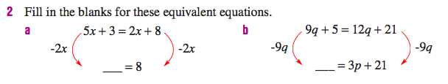


Your turn

Slide 11
24
7
30
Solving Multi-Step Algebraic Equations
Date
EQ – How do multi-step equations differ from one and two-step equations?
Solving Multi-Step
Equations
Don’t forget!!!
Summary:

Slide 12
Notes Review
24, 7 ,30
Date
Title
Essential question
Notes complete
Notes complete with colour and diagrams
Questions completed
Contents page filed in
Formula page filled in

